Slide 1

The Role of GPs in
Return to Work Programs
Dr Dilip Sharma
General Practitioner
MBBS. Master of Health Science (Occ. Med. Health & Safety), FRACGP
Notes:
Slide On Screen for Speaker to Come to Lectern
The Role of GPs in Return to Work Program
Speaker
Dr Dilip Sharma
General Practitioner
MBBS. Master of Health Science (Occ. Med. Health & Safety), FRACGP

Slide 2

The role of GPs in Return to Work Programs
Medical barriers
in return to
work programs
Suggestions
on improvement
Notes:
Introduction – this presentation will address
The Role of GPs in Return to Work Program
Medical Barriers in Return to Work Programs
Suggestions on Improvement

Slide 3

Issues and Facts
Being out of work for any extended period is bad for patients’ health
Notes:
Issues and Facts
It is well known, that being out of work for an extended period of time is bad for a patient’s health.
After 20 days of absence from work only 70% will return to work.
After 45 days, only 50% will return.
After 70 days, 35% will return to work.
After 12 months, less than 10% will ever return to work.

Slide 4

Issues and Facts
Adverse health effects to worker and community are huge and not well recognised.
Notes:
Though the ‘economic’ consequences of this are well recognised, the adverse health effects in the long run, to the worker and to the community at large, are huge and are less well recognised and addressed.

Slide 5

Issues and Facts
Health outcomes for compensable conditions are worse than for similar
non-work related condition.
Notes:
Despite the huge sums of money poured into Work Related health problems, the health outcomes for compensable conditions are worse than for similar non-work related conditions.

Slide 6

Issues and Facts
Length of time for worker to return to duty is major driver of claim costs
Notes:
The length of time it takes for the worker to return to duty is the single major driver of Claim Costs.

Slide 7

The Role of GPs in RTW Programs
Notes:
Suggested Improvements

Slide 8

The Role of GPs in RTW Programs – GP as Starting Point
GP in a dedicated occupational health practice
GPs experienced in W/C
Worker’s regular GP
Any other GP
Notes:
The Role of GP’s in Return to Work Programs
The GP as a starting point –
GP in a Dedicated Occupational Health Practice
GPs experienced in workers’ compensation
Worker’s regular GP
Any other GP

Slide 9

The Role of GPs in RTW Programs
– Initial Assessment and Treatment
Development of rapport
Examination, diagnosis, investigation
Appropriate treatment and referrals
Notes:
Initial Assessment and Treatment
Development of rapport
Examination, diagnosis, investigation
Appropriate treatment and referrals

Slide 10

The Role of GPs in RTW Programs
– Initial Assessment and Treatment
Do relevant paperwork
(W/C certificates)
Communication and initiation of RTW Plan
Notes:
Do the relevant paperwork (workers’ compensation certificates)
Communication and initiation of Return to Work Plan

Slide 11

GP Forms an Important Link
Worker Employer Insurer
GP
RTW C Specialists AHP
Notes:
The GP forms an important link
Worker Employer Insurer
GP
RTW C Specialists AHP

Slide 12

GP Follows Up Progress of Worker
Directly supervises
ongoing medical treatment
Reviews patient’s progress at regular intervals
Notes:
GP follows up progress of worker
Directly supervises ongoing medical treatment
Reviews patient’s progress at regular intervals

Slide 13

Maintains communications
Involvement in RTW Plan
Addressing worker’s psycho-social factors
Follow up to Final Certificate
Notes:
Maintains communications – most important
Involvement in Return to Work Plan
– requires detailed knowledge of worker’s job
– visit to the site is ideal to familiarise
Addressing worker’s psycho-social factors
– with time, this gets increasingly important
Follow up to Final Certificate

Slide 14
Medical Barriers in RTW
Notes:
Suggested Improvements

Slide 15

Medical Barriers in Return to Work Programs
Study by Institute for Safety, Compensation and Recovery Research (ISCRR) in collaboration with Monash University’s Department of Preventative Medicine to examine the Patterns of the Sickness Certificates given to W/C patients in Victoria (Published Oct 2013 Med Journal of Australia)
Notes:
Study by Institute for Safety, Compensation and Recovery Research (ISCRR) in collaboration with Monash University’s Department of Preventative Medicine to examine the Patterns of the Sickness Certificates given to workers’ compensation patients in Victoria (Published Oct 2013 Med Journal Of Australia)

Slide 16

Medical Barriers in Return to Work Programs – ISCRR Study
2003 – 2010 8 Years
120,000 W/C Certificates
First large scale study of its kind conducted in Australia
Notes:
ISCRR Study
2003 – 2010 8 Years
120,000 W/C Certificates
First large scale study of its kind conducted in Australia

Slide 17
Initial Certificates - ISCRR Study
Totally Unfit to Work 74%
Alternate Duties 23%
Fit for Pre Injury Duties 3%
Notes:
ISCRR Study
Initial certificates
Totally unfit for work 74%
Fit for Alternate duties 23%
Fit for pre-injury duties 3%

Slide 18
Totally Unfit Certs - ISCRR Study
MHC 94%
Fractures 81%
Other Injuries 79% (L/W etc)
Back Injuries 77%
M/S Injuries 68%
Alternate duties: Longest duration for MHC and Fractures
Notes:
Totally unfit certificates
(1 to 30 days) incidence and duration
MHC 94%
Fractures 81%
Other Injuries 79% (L/W etc)
Back Injuries 77%
M/S Injuries 68%
Alternate duties – longest duration for MHC and Fractures

Slide 19
Factors that influenced GP attitudes about RTW - ISCRR Study
MHC
Doctor-Patient relationship
Consultation time restraints
Limited knowledge of workplace
Fear of personal safety
Administrative burden
Notes:
Factors that influenced GP attitudes about Return to Work
Mental Health Condition
Doctor-Patient relationship
Limited knowledge of workplace
Fear of personal safety
Administrative burden

Slide 20
Difficulties GPs May Experience
Notes:
Suggested Improvements

Slide 21

Starting Point
GP in a dedicated occupational health practice
GPs experienced in W/C
Worker’s regular GP
Any other GP
Notes:
Medical Barriers in Return to Work Programs – Difficulties GPs may experience
GP in a dedicated Occupational Health Practice
GPs experienced in workers’ compensation
Worker’s regular GP
Any other GP

Slide 22

Rapport
Important in building a trusting therapeutic relationship
Notes:
Rapport
Important in building a trusting, therapeutic relationship
Pros and Cons

Slide 23

Motivation and Commitment
Unsure of W/C process
Negative perceptions
Time weighted consults
Bottom line –
“not worth
my time”
Notes:
Motivation and Commitment – most important
Unsure of Workers’ Compensation Process
Negative Perceptions
Time weighted consults
Bottom line – “not worth my time”

Slide 24

Management
<1 to 5% workload
Limited knowledge/ experience in W/C
Remain focused on
physical condition
Do not consider RTW
as part of their role
No clear guidelines in W/C
Discouraged by paperwork
Notes:
Management
<1 to 5% workload
Limited knowledge and experience in workers’ compensation
Remain focused on physical condition
Do not consider Return to Work as part of their role
No clear guidelines in Workers’ Compensation
Discouraged by paperwork

Slide 25

Communications
Barriers to involvement in RTW Plan – Time/Employers
Dilemma of GP role – confidentiality issues/co-existing issues
Conflicting messages – Worker/AHP
Notes:
Communications
Involvement in the Return to Work Plan – Time/Employers
Dilemma of GP role – confidentiality issues / co-existing issues
Conflicting Messages – Worker/AHP

Slide 26

Rehabilitation
Reducing role
of GPs with time
Increasing stalemate
– non medical barriers
Frustrations
Delays in RTW
Notes:
Rehabilitation
Involvement of other stakeholders is more important
Reducing role of GPs with time
Increasing stalemate – non medical barriers
Frustrations
Delays in Return to Work

Slide 27
Suggested Improvements
Notes:
Suggested Improvements

Slide 28

Choosing the right starting point
GP in a dedicated occupational health practice
GPs experienced in W/C
Worker’s regular GP
Any other GP
Notes:
Choosing the right starting point – if you have a choice?
GP in a dedicated occupational health practice
GPs experienced in workers’ compensation
Worker’s regular GP
Any other GP

Slide 29

The consultations
Sufficient time
Natural history
RTW Plan
Patient’s attitude
Early screening
Evidence based treatment
Early interventions
Notes:
The Consultations
Sufficient time – should be provided to address the patient’s issues and concerns.
Workers need to be educated about natural history of the condition.
Worker should be given a clear RTW Plan and explained the negative consequences of remaining off work. Returning to work with residual or partial disability has a better outcome than staying out of work.
GPs need to be aware that the patient’s own attitude has a huge impact on their Return to Work process.
Early screening should be done to identify workers at risk of longer disability.
Early interventions within a clear framework, to address psycho-social factors should be available.

Slide 30

ill health
mental stress
Notes:
ill health - mental stress - ill health
A vicious circle.

Slide 31

Medical Leave for Disability
Medically necessary
Medically discretionary
Medically unnecessary
Notes:
The Consultations
Suggested Improvements
Medical Leave for Disability
Medically necessary – acute treatment phase
Medically discretionary – during partial functional impairment
Medically unnecessary – non medical issues masquerading as medical issue

Slide 32
Increasing GP contact with
RTW Co-ordinator
On the spot training
Better understanding of work requirement, and available alternate duties
Queries immediately cleared
Better feedback of progress
Better able to specify restrictions
Notes:
Increasing GP contact with Return to Work Co-ordinator (case conferencing)
On the spot training opportunities.
GPs get a better description and understanding of work requirements, and available alternate duties.
GP is not in a dilemma as queries by worker and doctors are immediately cleared.
GP gets better feedback of patient’s progress at work.
GP is better able to specify the restrictions, and improves the Return to Work Plan.

Slide 33

Early involvement of specialists/rehab providers/ independent opinions
Clears any doubts
Strengthens diagnosis
and evidence-based management plan
Early management of
psycho-social issues
Supports early RTW
Notes:
Early involvement of specialists / rehabilitation providers / independent opinions
Clears patients and GP’s doubts, if any, and helps reassure all parties, early in the process
Strengthens diagnosis and evidence-based management plan.
Early management of medical condition and psycho-social issues are addressed.
Supports early Return to Work.

Slide 34

Training of GPs
Undergraduate level
Clear guidelines and evidence based medicine relevant to RTW
Stakeholder initiative training
Notes:
Training of General Practitioners.
Routine training of doctors at undergraduate level in the management of Return to Work.
Ongoing training with clear guidelines to GPs (via seminars, talks, journals, web-based transformation of information) about evidence-based medicine relevant to Return to Work and negative consequences of keeping patients away from work.
Any of the stakeholders could take initiative on training (employers, insurers, WorkCover, RACGP, AMA).
.

Slide 35

Training
More knowledge,
more confidence
Less apprehension,
less negativity
Greater involvement
in RTW Plans
Achieve Early RTW
Notes:
With training, general practitioners get:
More knowledge, more confidence.
Less apprehension, less negativity.
Greater involvement in Return to Work Plans.
Achieve early Return to Work.

Slide 36
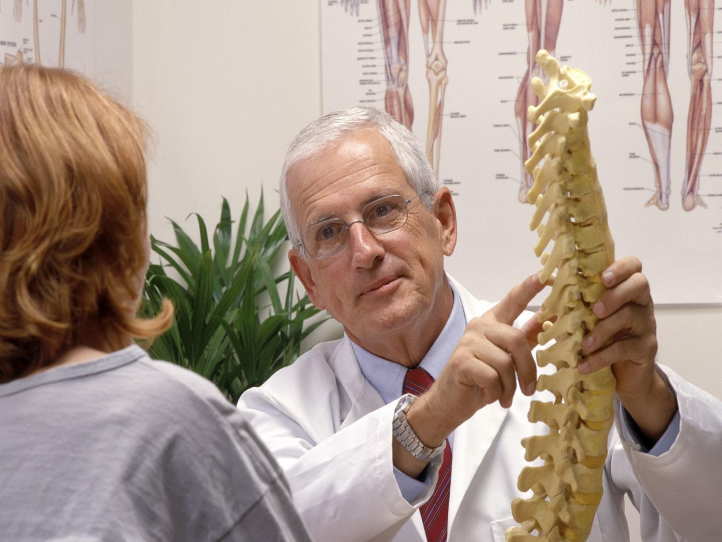
Bottom Line
Financial reimbursement
Payment incurred a negligible expense
Notes:
The bottom line – is financial reimbursements to GPs.
It will be naïve if we do not admit it … that it matters!
Payment incurred to GPs is a negligible expense in the total cost of the whole claim. (Actual and Hidden costs).

Slide 37

3 Most Common Reasons for Hesitation
Unsure of the process
Negative perception of W/C outcomes
Not worth my time
Notes:
The three most common reasons given by GP’s who hesitate regarding workers’ compensation are:
They are unsure of the process.
They have a negative perception of the workers’ compensation outcomes.
They perceive the process as ‘not worth my time’.

Slide 38
Summary
Early return to work is paramount in achieving a
better outcome and the barriers to early RTW are multi-factorial (medical/
non-medical)
Notes:
In summary
Early return to work is paramount in achieving a better outcome and the barriers to early Return to Work are multi-factorial.
Medical/Non-Medical.

Slide 39
To achieve our aspirations towards the well-being of the employees and the community, all stakeholders (governments, compensation authorities, employers and health practitioners) require a co-ordinated approach, partnership and the political will.
Notes:
To achieve our aspirations towards the well-being of the employees and the community, all stakeholders (governments, compensation authorities, employers and health practitioners) require a co-ordinated approach, partnership and the political will.

Slide 40

Thank you for your time
Notes:
Thank you for your time.

